Slide 1
CO2402 - Advanced Programming with C++
Week 19 – Deep and shallow copy
Gareth Bellaby

Slide 2
Topics
Deep and Shallow Copying
Protected
Multiple Inheritance
Operators

Slide 3
Topic 1
Deep and shallow copy

Slide 4
Copy constructor
The copy constructor is used to create a copy of an object. A copy constructor is automatically created for all objects.
Whenever C++ needs to make a copy of an object it uses the copy constructor. It must do this.
  A copy of the object is required for call by copy.
  A function that returns a value of the class type will invoke the copy constructor.
It is also the case that it useful to create copies of an object.

Slide 5
Copy constructor
e.g., call by copy requires a copy constructor .
void foo( CClass myClass )
{
// body of function
}
int main()
{
CClass myClass;
foo( myClass );
}

Slide 6
Copy constructor
It is good that a copy constructor is automatically created for all objects.
It is often the case that you can just use the copy constructor created.
However, the copy constructor does not always do what you expect it to do.
The problem arises with any object that uses a pointer and dynamically allocated memory.
This is a fiddly problem and it requires some thought and careful implementation.

Slide 7
Demonstration of error 1
class CValue
{
private:
int* mpData; // Pointer, memory gets allocated
public:
CValue( )
{ mpData = new int; };
void Set( int data )
{ *mpData = data; };
void Display( )
{ cout << *mpData << endl; };
};

Slide 8
Demonstration of error 1
void foo( CValue copy )
{
cout << "copy in foo: ";
copy.Display(); // Output: 2
copy.Set( 3 );
cout << "copy in foo: ";
copy.Display(); // Output: 3
}

Slide 9
Demonstration of error 1
void main()
{
CValue original;
original.Set( 2 );
cout << "original: ";
original.Display(); // Output: 2
foo( original );
cout << "original: ";
original.Display(); // Output: 3!
// NOT WHAT WE WANT!
}

Slide 10
Understanding the error
The error has been caused by the default copy constructor.
When the function is called a copy of the object is made.
The copy is exact (as you would expect).
The copy is of the object itself.
Any dynamically allocated data pointed to within the object is not copied over.
Rather the contents of the pointer is copied over and now both the original and the copy have a pointer to the same block of memory.

Slide 11
Solution - write your own
The solution is to write your own copy constructor.
The copy constructor is a constructor that has one parameter that is the same type as its own class.
The one parameter must be a call by reference.
By convention the one parameter is a constant.
The copy constructor will explicitly carry out operations such as creating a new block of dynamically allocated memory.

Slide 12
Copy constructor
When you write a copy constructor, the parameter must be call by reference for the class.
What would happen otherwise ?
Call by value would itself invoke a copy constructor!

Slide 13
Demonstration of solution 1
class CValue
{
private:
int* mpData;
public:
CValue( const CValue& theOriginal );
CValue( ) { mpData = new int; };
void Set( int data )
{ *mpData = data; };
void Display( )
{ cout << *mpData << endl; };
};

Slide 14
Demonstration of solution 1
User built copy constructor.
Dynamically allocate a new block of memory for the new copy of the object.
Then copy over the data.
CValue::CValue( const CValue& theOriginal )
{
cout << "copy constructor called" << endl;
mpData = new int;
*mpData = *theOriginal.mpData;
}

Slide 15
Demonstration of solution 1
void main()
{
CValue original;
original.Set( 2 );
cout << "original: ";
original.Display(); // Output: 2
foo( original ); // copy gets changed
cout << "original: ";
original.Display(); // Output: 2, which is
// correct
}

Slide 16
Shallow copy
Shallow copy. A copy of the object, but not any dynamically allocated memory pointed to by the object.
The effect of shallow copy is that a copy of the object will point to the same memory block(s) of dynamically allocated memory as that of the original.
Shallow copy is what the default copy constructor performs.
Copy is of the object itself - the "topmost layer", if you like. This is why is it called shallow copy.

Slide 17
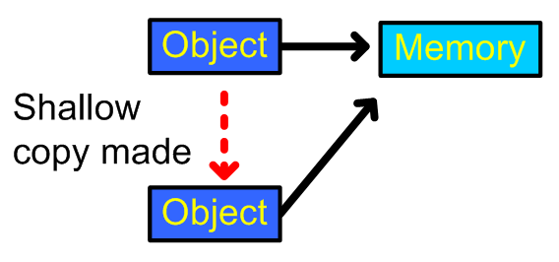
Shallow copy

Slide 18
Deep copy
Deep copy. A copy of the object and any dynamically allocated memory pointed to by the object.
Written by the programmer.
You need to write the copy constructor to accommodate the particular class - its data structures.
Copy is of the object itself and anything hanging off it - the "topmost layer" and the "lower layers". This is why is it called deep copy.

Slide 19
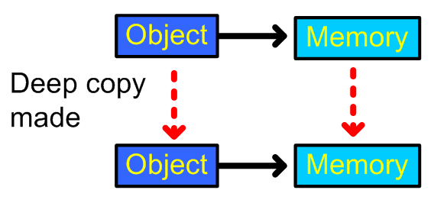
Deep copy

Slide 20
Deep copy and pointers
The example I've given used a value object.
Deep copy is needed for reference objects.
It is also necessary for any object that contains dynamic memory allocated and a pointer.
You'll note that the problem occurs here with the assignment operator, not a call by copy to a function.
The solution is to override the assignment operator for this class.

Slide 21
Demonstration of problem 2
void main()
{
CPointer* original = new CPointer( );
CPointer* copy = new CPointer( );
original->Set( 2 );
*copy = *original;
original->Display(); // Output: 2
copy->Display(); // Output: 2
copy->Set( 3 );
original->Display(); // Output: 3
copy->Display(); // Output: 3
}

Slide 22
Demonstration of solution 2
class CPointer
{
private:
int* mpData;
public:
CPointer operator = ( const CPointer& );
CPointer( )
{ mpData = new int; };
void Set( int data )
{ *mpData = data; };
void Display( )
{ cout << *mpData << endl; };
};

Slide 23
Demonstration of solution 2
CPointer CPointer::operator =
( const CPointer& operand )
{
cout << "assignment operator called\n";
*mpData = *operand.mpData;
return *this;
}

Slide 24
Demonstration of solution 2
CPointer* original = new CPointer( );
CPointer* copy = new CPointer( );
original->Set( 2 );
copy->Set( 5 );
original->Display(); // Output: 2
copy->Display(); // Output: 5
*copy = *original;
original->Display(); // Output: 2
copy->Display(); // Output: 2
copy->Set( 3 );
original->Display(); // Output: 2
copy->Display(); // Output: 3
original->Set( 9 );
original->Display(); // Output: 9
copy->Display(); // Output: 3

Slide 25
Deep copy and pointers
The solution works because it has overridden the behaviour of the default copy constructor.
The code forces a copy of the data to happen, rather than a copy of the address of the pointer.

Slide 26
Dynamically allocated arrays
The problem will also effect dynamically allocated arrays.
See the lab worksheet.

Slide 27
Topic 2
Inheritance - protected

Slide 28
protected
You have seen the keywords public and private for data members and methods.
There is a third type: protected.
Protected allows you to create class members that are private to their class but that can still be inherited and accessed by a derived class.
In the base class protected is equivalent to private.
In the derived class the method or data member remains protected

Slide 29
protected
class CBase
{
protected:
int mData;
CBase( int data): mData( data ) {};
void Display()
{ cout << mData << endl; };
};

Slide 30
protected
class CDerived : public CBase
{
public:
CDerived( int data ) : CBase( data ) { } ;
void NewDisplay()
{ cout << mData << endl; };
};

Slide 31
Should you use protected for data members?
OK to use protected methods.
Some debate about protected data members.
Some programming authorities say that it is bad practice to use protected data members.
The objection is that it breaks encapsulation.
My own view is that it is generally better for a derived class to use getters and setters, rather than to use protected data members and allow direct access. However, this is just my opinion.

Slide 32
Relationship of the three
The access status is either public, private or protected.
The derived class can make three types of modification to the base class: private, public and protected.

Slide 33
Base-Derived Combinations
 |  | Derived Class
 |  | private | protected | public
Base Class | private | none | none | none
 | protected | private | protected | protected
 | public | private | protected | public

Slide 34
Topic 3
Multiple inheritance

Slide 35
Multiple Inheritance
Inherit from two or more base classes.
Takes advantage of the properties of more than one existing class.
Combine the features of multiple classes into one new class, and then extend those features as necessary.
Debate about multiple inheritance because it can be regarded as bad practice because it undermines encapsulation.
May be useful with interfaces, e.g. define a abstract base class with an interface, inherit interface from the base class but some functionality from another class.

Slide 36
Multiple Inheritance
To inherit more than one base class you:
  use a comma separated list
  provide an access specifier for each base inherited.

Slide 37
Multiple Inheritance
class base1
{
// class definition
};
class base2
{
// class definition
};
class derived: public base1, public base2
{
// derived class definition
};

Slide 38
Topic 4
Operators

Slide 39
The ? operator
Replaces the if-else statement:
a > b ? max = a : max = b2;
The section before the ? is the conditional statement.
The middle section is executed if the conditional is true.
The end section is executed if the conditional is false.

Slide 40
The ? operator
int a;
int b;
int max;
a > b ? max = a : max = b;
if(a > b)
{
max = a;
}
else {
max = b;
}

Slide 41
Shorthand operators
There is a common need to write the following type of code:
a = a + b;
There are shorthand operators for this type of operation. They do not make the code more efficient. They are merely shorter.

Slide 42
Shorthand operators
shorthand | code | equivalence
+= | a += b; | a = a + b;
-= | a -= b; | a = a - b;
*= | a *= b; | a = a * b;
/= | a /= b; | a = a / b;

